Slide 1

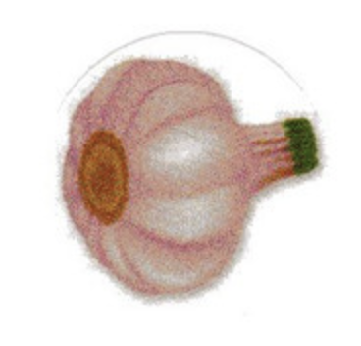
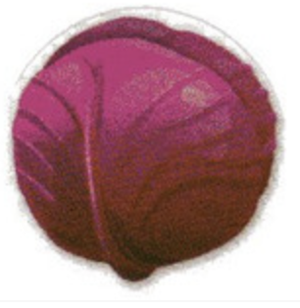


fruits
vegetables

Slide 2
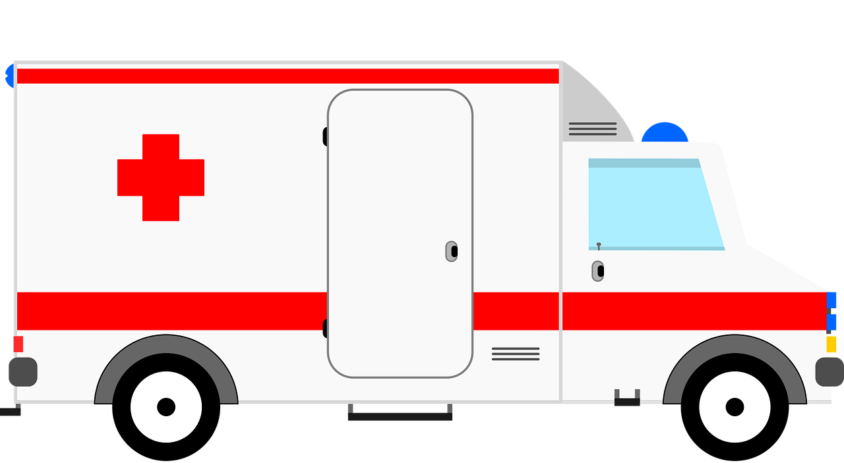
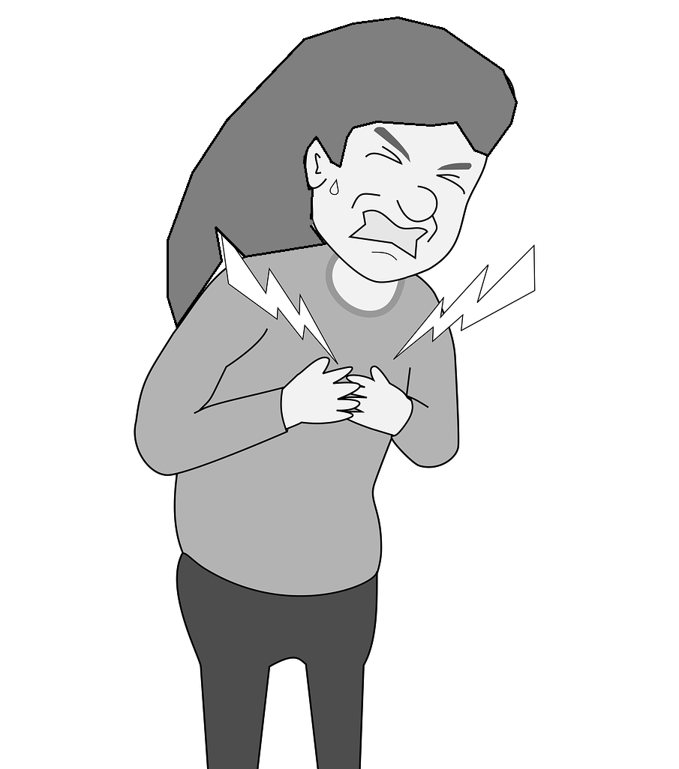
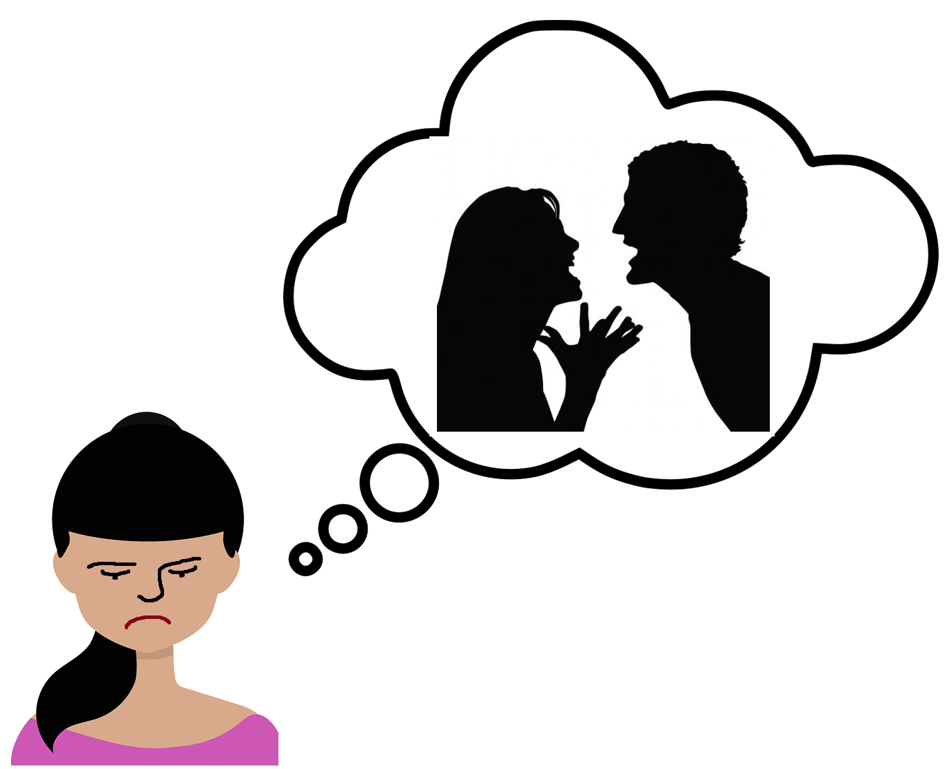
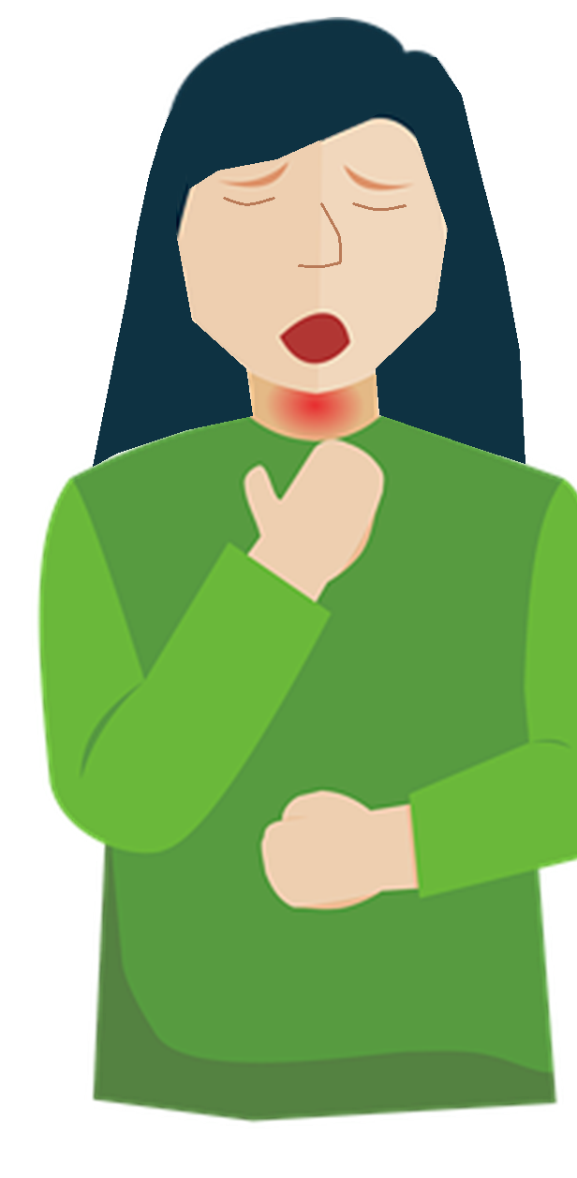
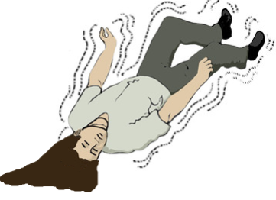
Go to emergency TODAY if you have any of these symptoms
Violent Thoughts
Cheat Pain
Trouble Breathing
Seizures

Slide 3
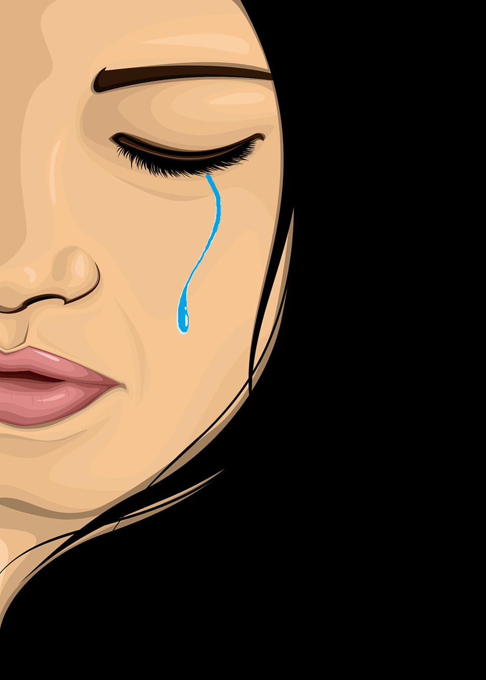
Go to emergency TODAY if you have any of these symptoms postpartum
Trouble Breathing
You have unusual thoughts about hurting yourself or your baby. You might not feel like yourself.
This could be a sign of
post-partum depression

Slide 4
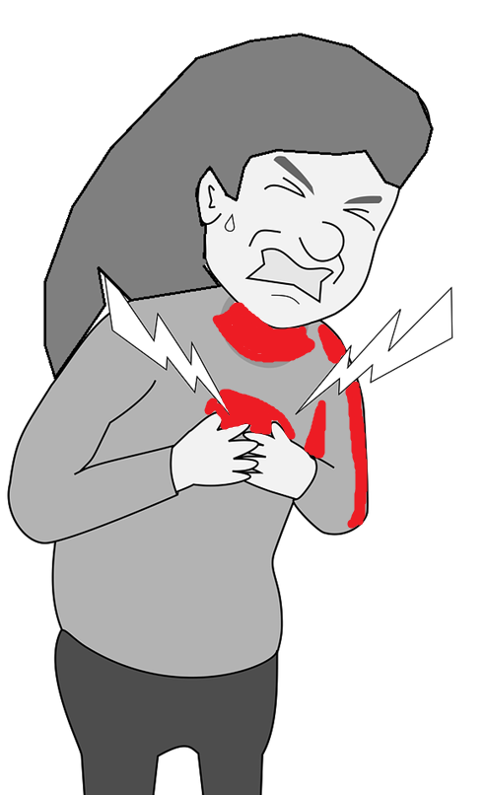
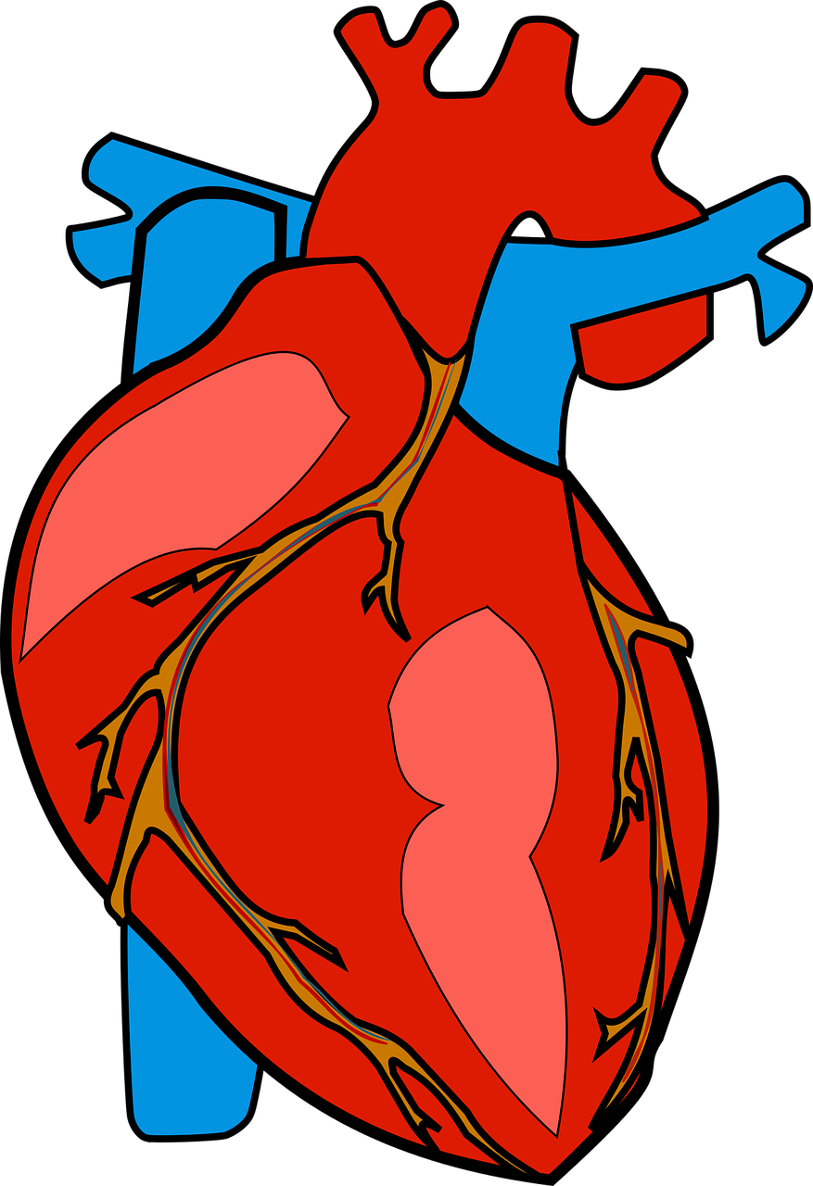
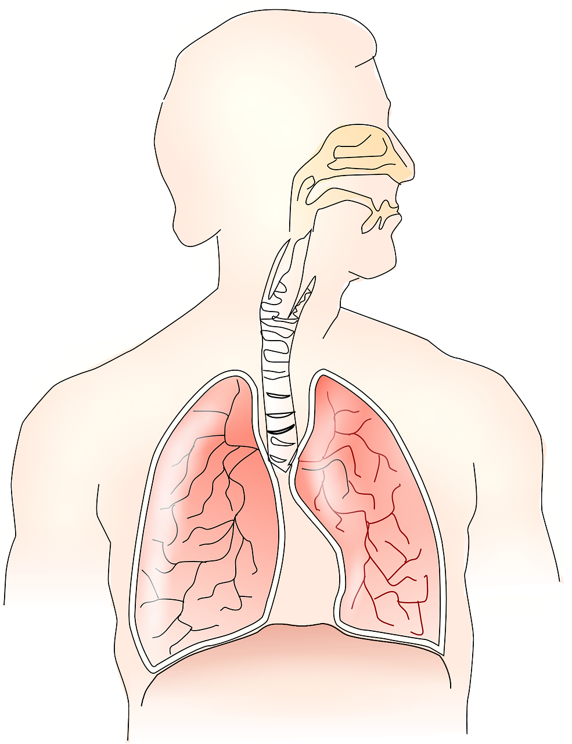
Go to emergency TODAY if you have any of these symptoms postpartum
Chest Pain
Any symptom like fast or irregular heartbeat, pain that moves to your arm or neck, tightness in chest,
Watch out for: sudden onset, swelling, dizziness or confusion, trouble breathing, headache.
This could be a sign of heart attack or a blockage in your lungs

Slide 5
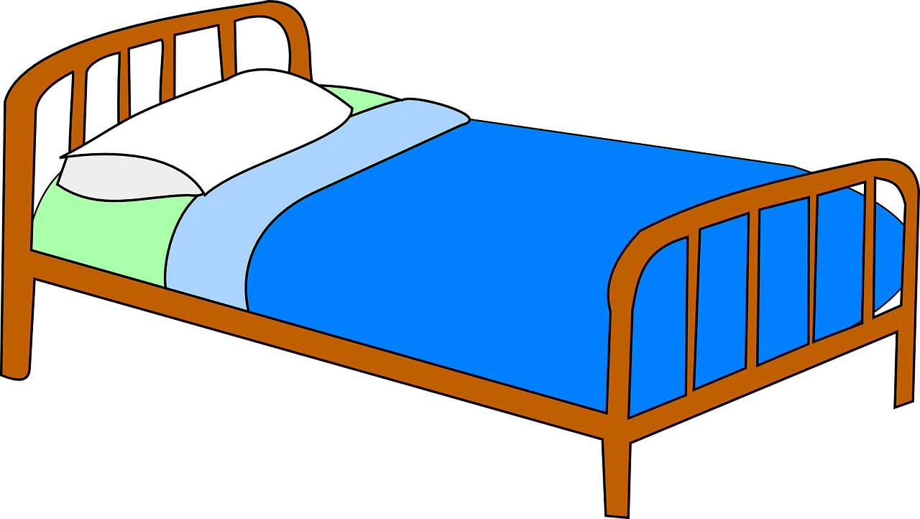
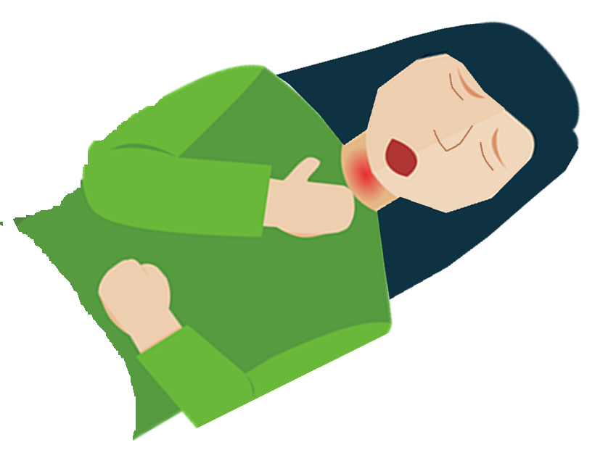
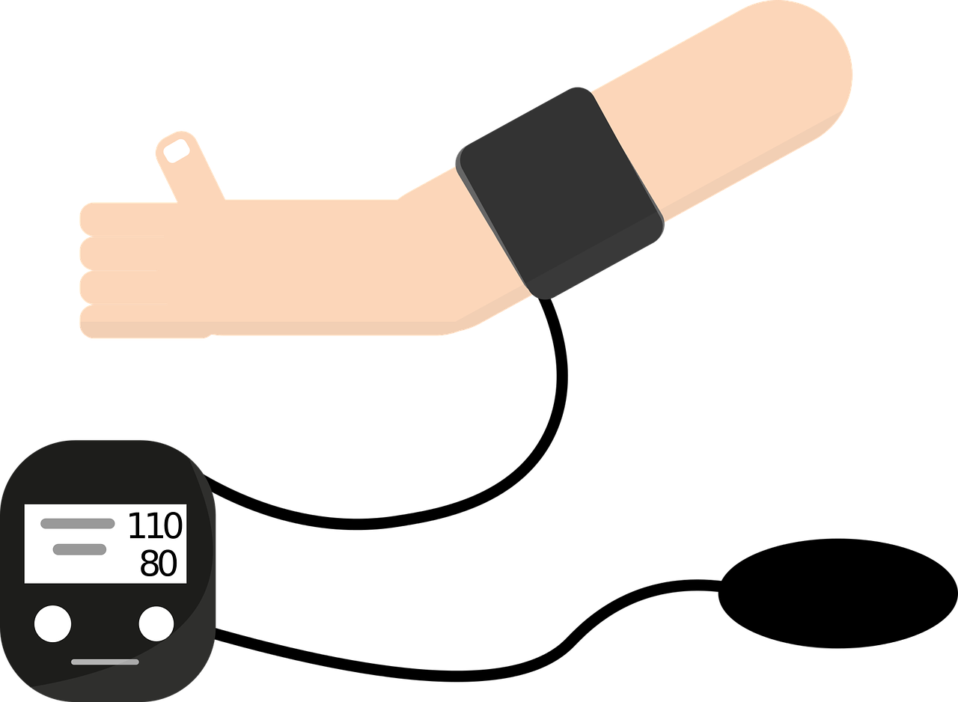

Go to emergency TODAY if you have any of these symptoms postpartum
Trouble Breathing
You can’t get enough air when you breathe, or your chest or throat is tight, or you can’t breathe when you’re lying down
Watch out for: swelling, chest pain, headache, dizziness, changes in vision, or a fast heartbeat
This could be a sign of eclampsia: a medical emergency

Slide 6
Go to emergency TODAY if you have any of these symptoms postpartum
Seizures
You suddenly lose consciousness and have a seizure – your body becomes stiff and shakes and convulses.
This could be a sign of eclampsia: a medical emergency

Slide 7

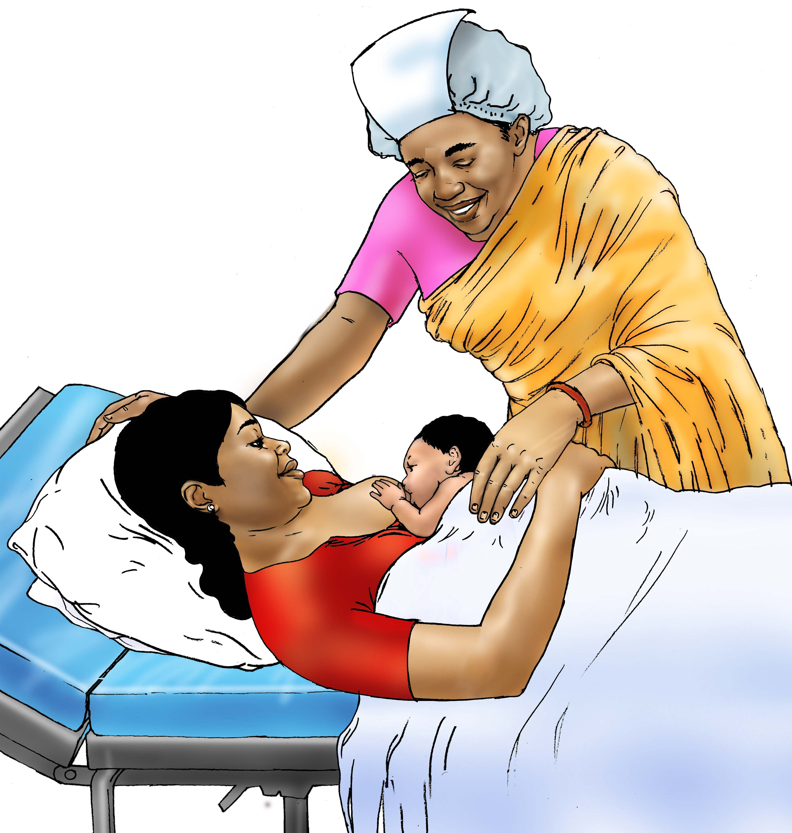
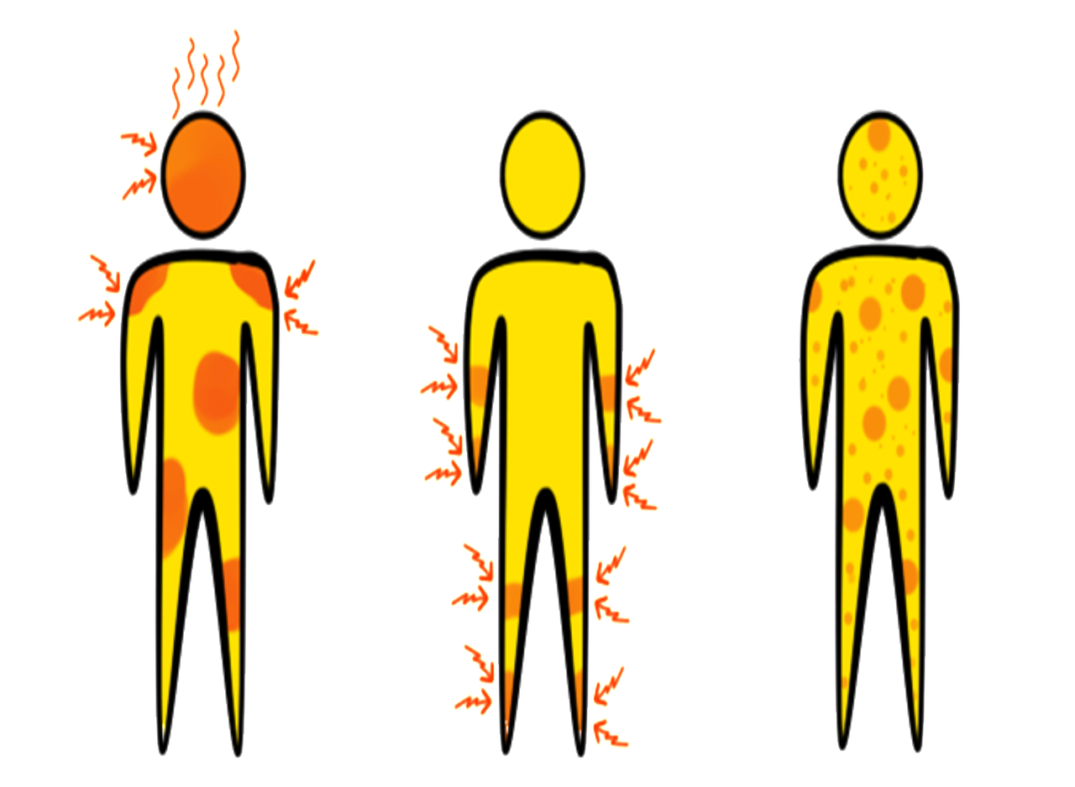
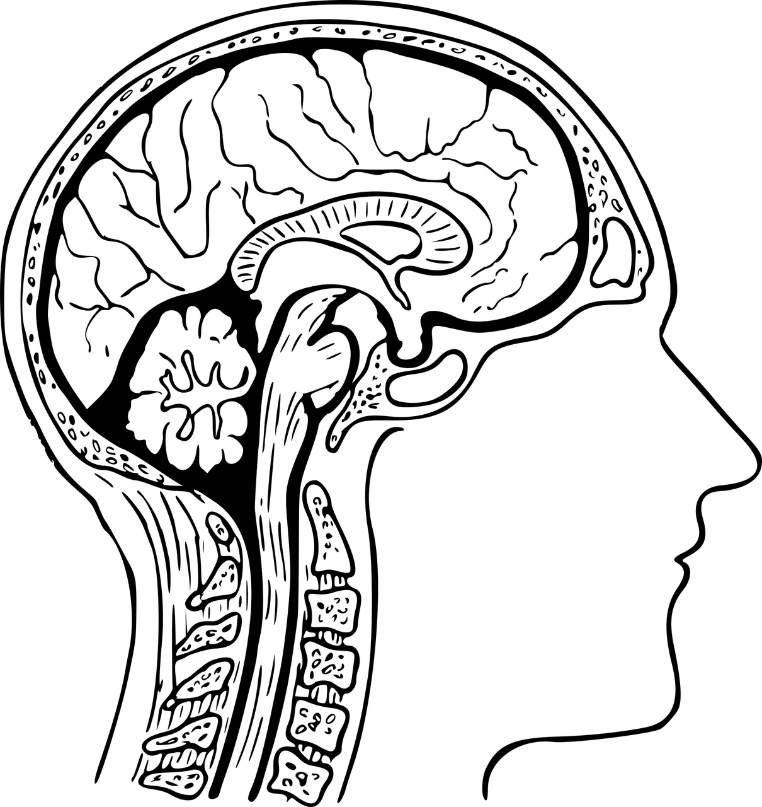
Go to a health center to check for and manage these conditions
Eclampsia
Eclampsia is a very dangerous condition that quickly causes seizures, coma, or death. It usually happens in the 2 days after giving birth.
Women that have pre-eclampsia during pregnancy are at higher risk. They should give birth in a hospital

Slide 8
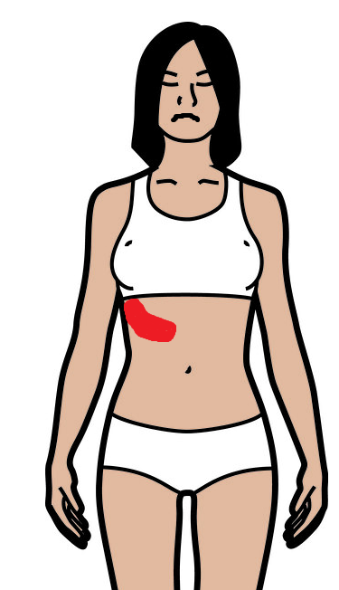

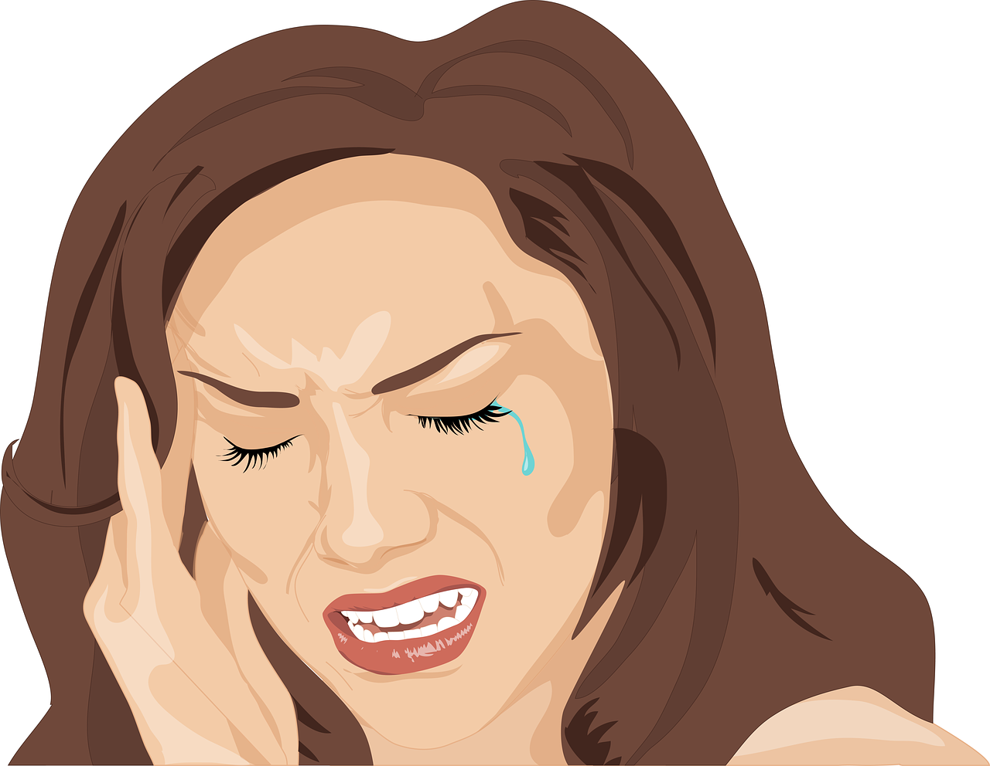

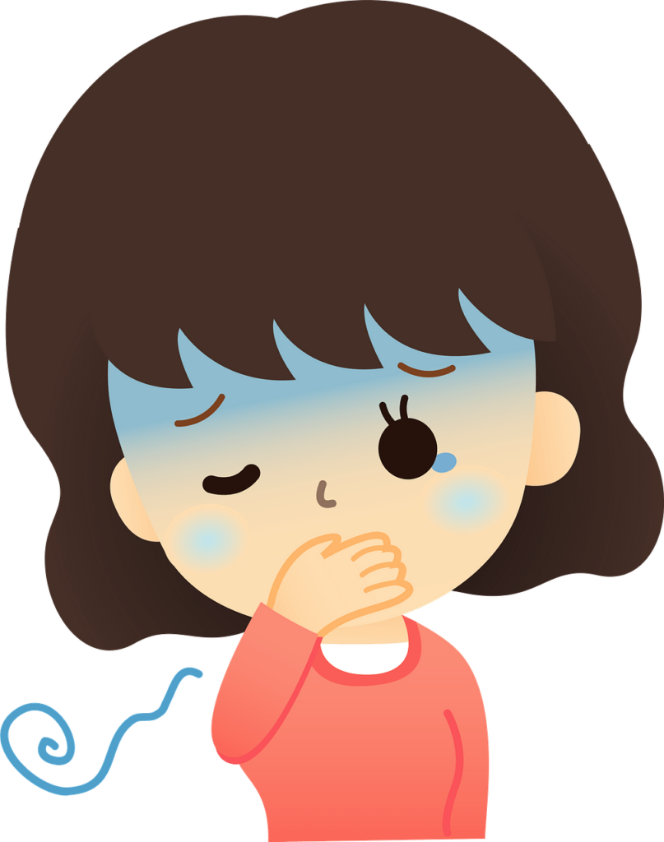
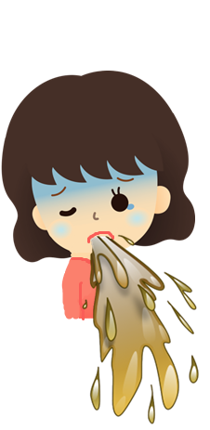
Eclampsia
Seizures
Pain under the right rib
Severe headaches
Changes in vision
Nausea/Vomiting
Hard to breathe

Slide 9
Eclampsia
Eclampsia is a medical emergency.
It needs to be treated in the hospital immediately.

Slide 10
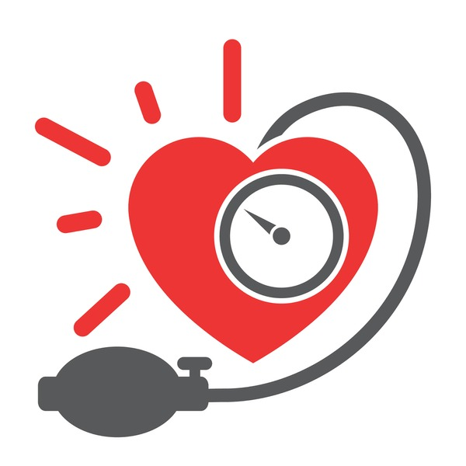
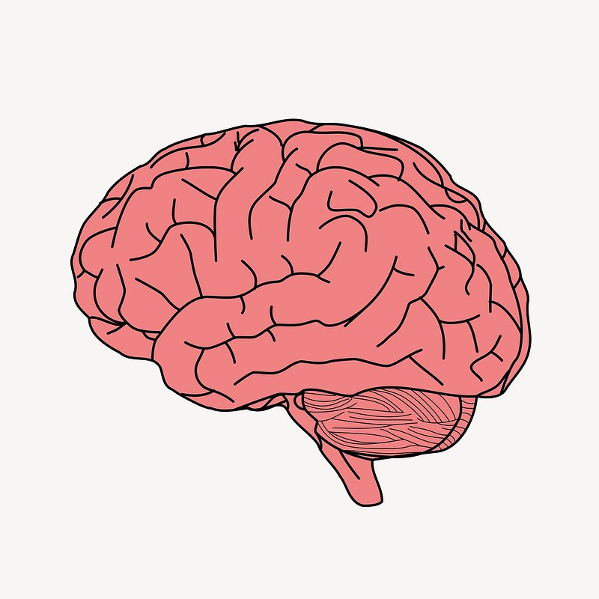
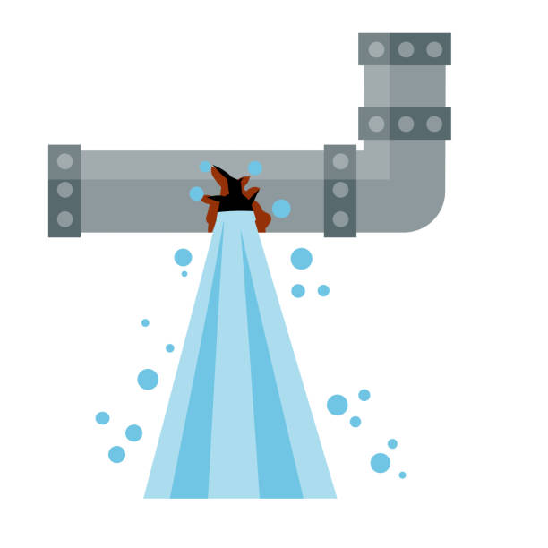
Eclampsia
Your brain needs a lot of blood. Blood brings it fuel so that it can control your body and keep you alive.
When a pregnant woman has high blood pressure, it’s harder for enough blood to reach her brain, like water trying to flow through a small tube.

Slide 11

Go to a health center to check for and manage these conditions
Post-partum depression
After birth, some women become very sad, anxious, and tired. It can become severe and last for a long time.
This is a medical condition; it is not a weakness or because of the woman’s personality.

Slide 12
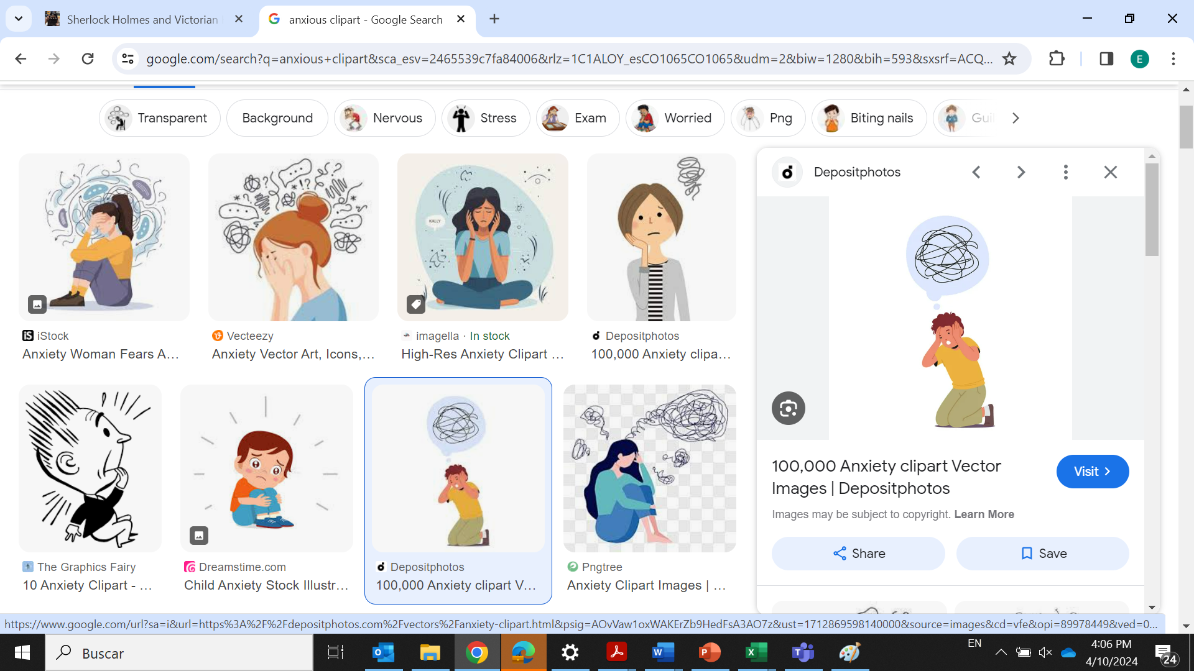
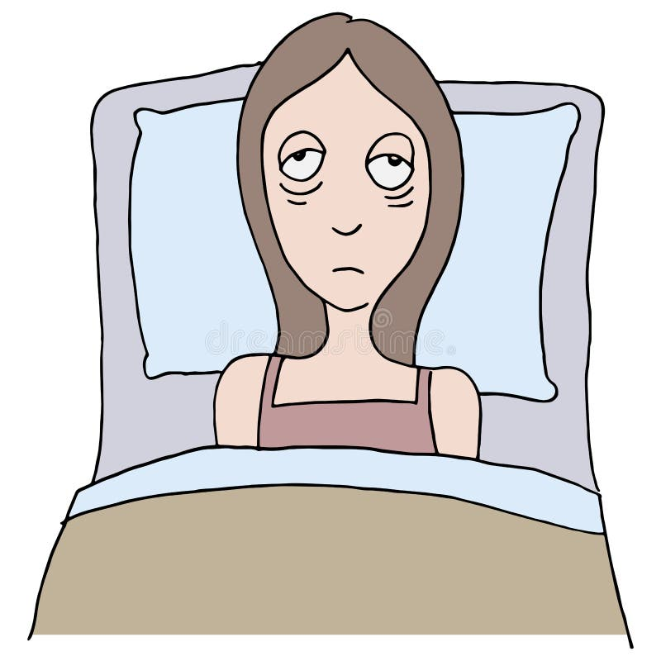

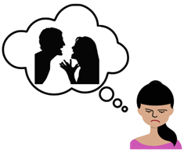
Post-partum depression
Thinks about hurting herself or her baby, doesn’t feel connected to her baby
Crying, trouble sleeping, can’t do daily tasks
Bad memory or hard to pay attention

Slide 13
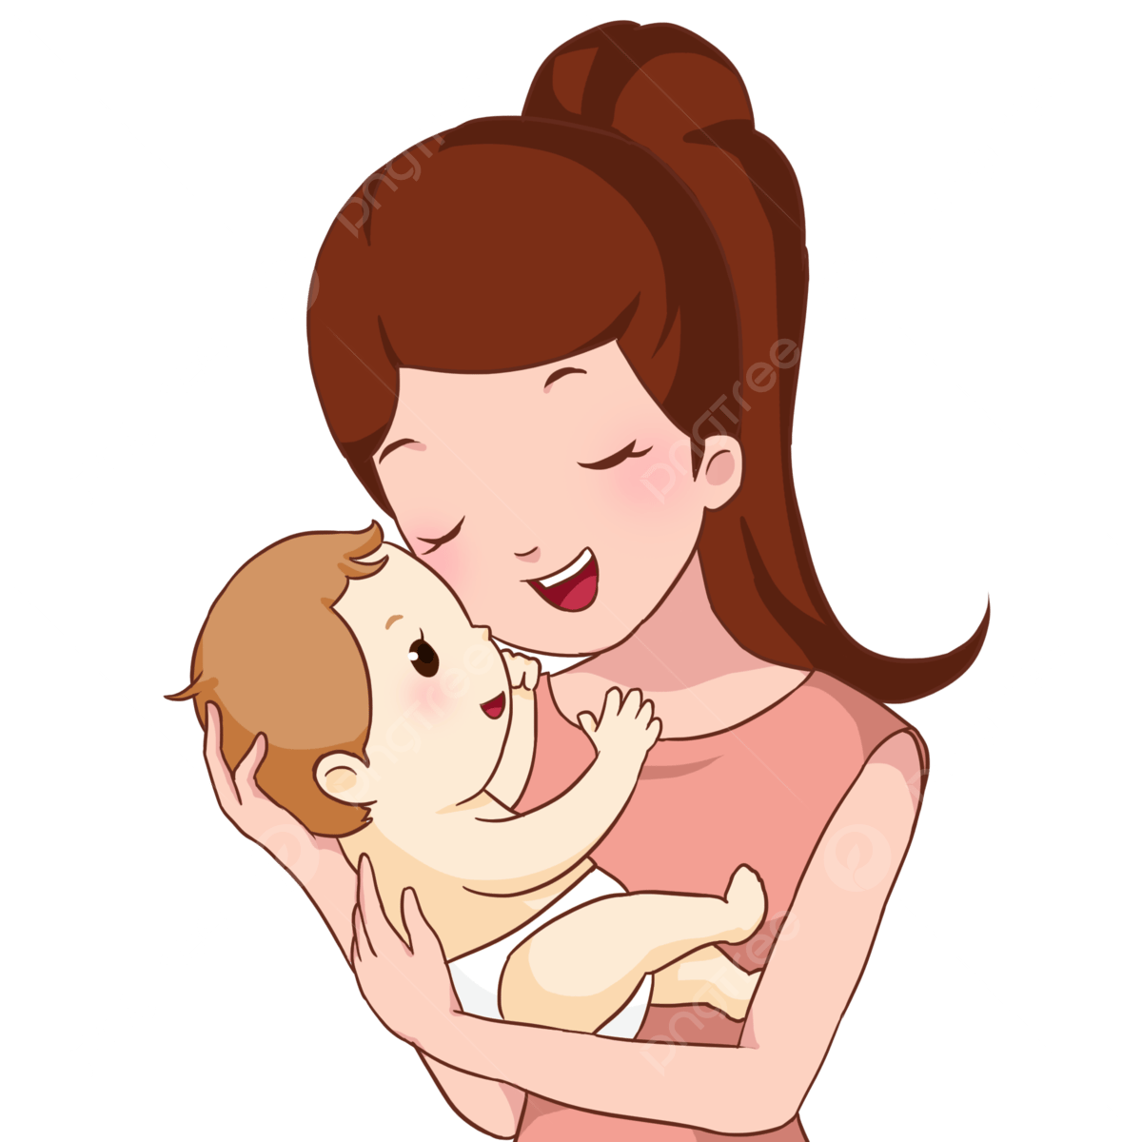
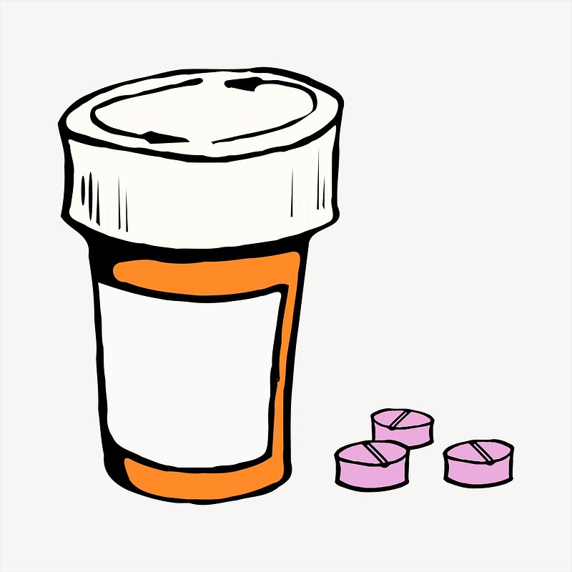
Post-partum depression
Post-partum depression can be treated with medicine that helps the brain return to its normal moods and thoughts.
Sometimes it is caused by a change in hormones, so it can be treated by hormone pills.

Slide 14
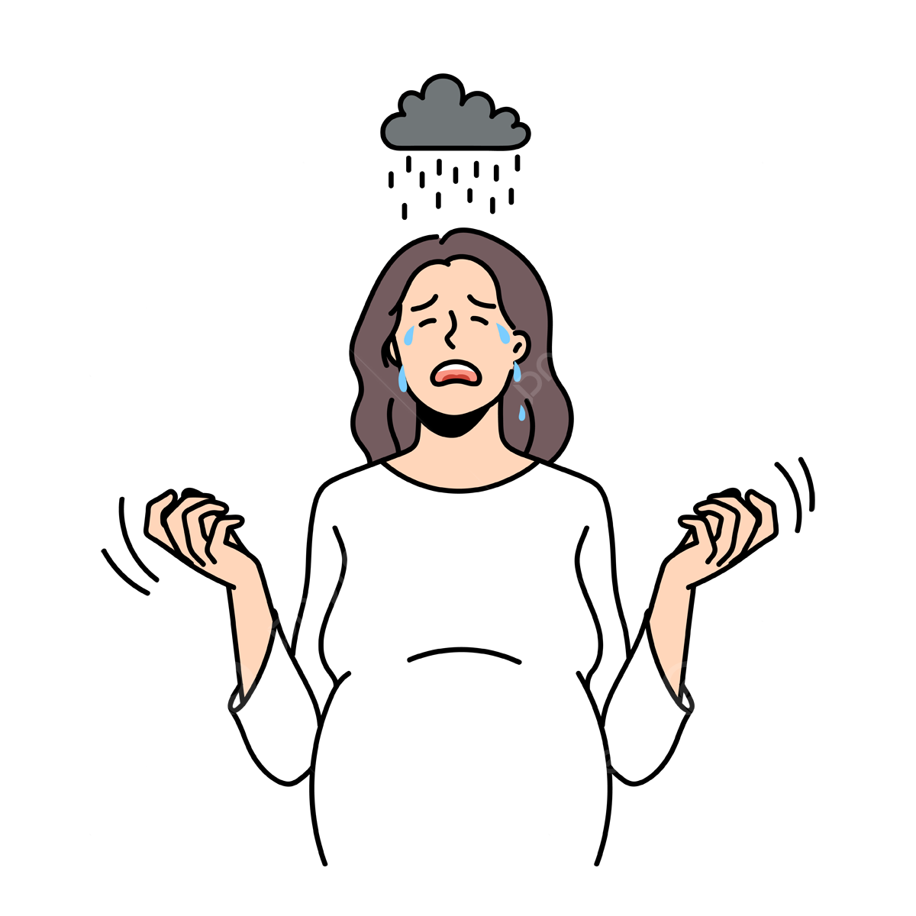
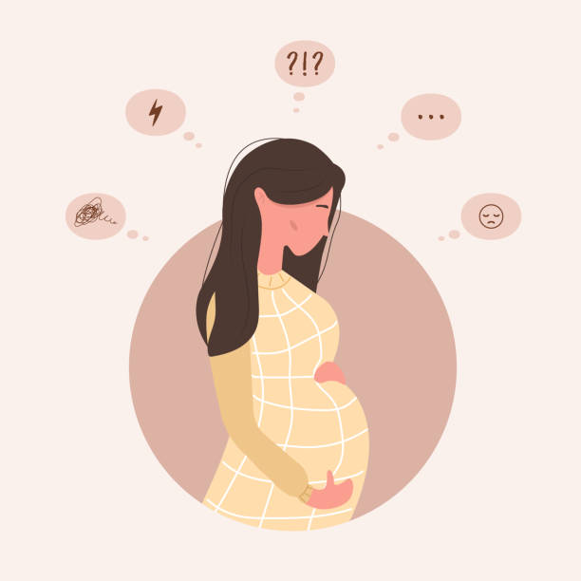
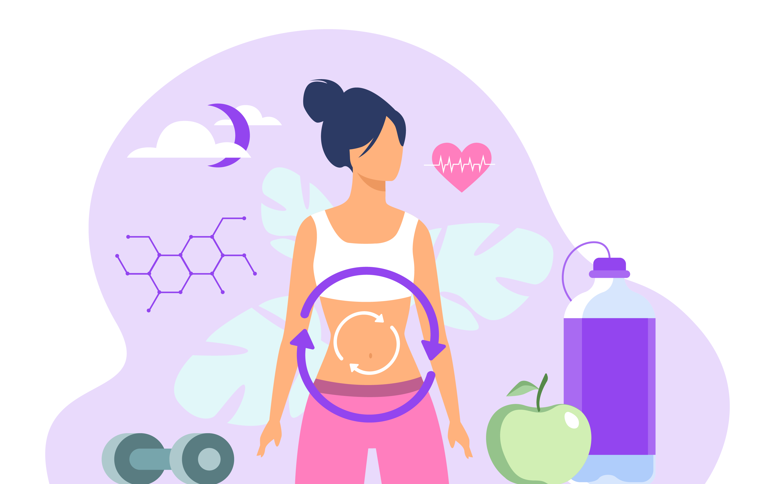
Post-partum depression
Hormones are powerful chemicals that our body uses to control many processes.
During pregnancy and after birth, there are many hormones in the body.
Hormones can affect the way that the brain works, and cause depression if they are out of balance.

